Slide 1
Hotel Management
By
Praveen

Slide 2

introduction
In this application is customers visits the hotel
The hotel management is maintain the record
All the records maintaining customer support

Slide 3


primary goals

Slide 4



quarterly performance

Slide 5
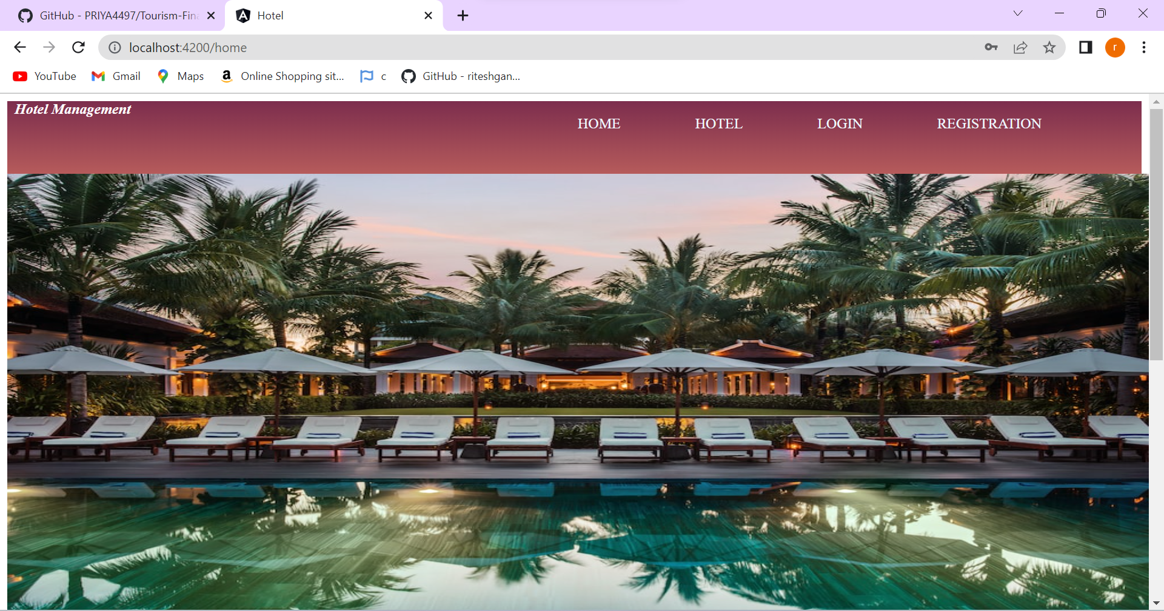
RICHARD BRANSON
“Business opportunities are like buses. There's always another one coming.”

Slide 6
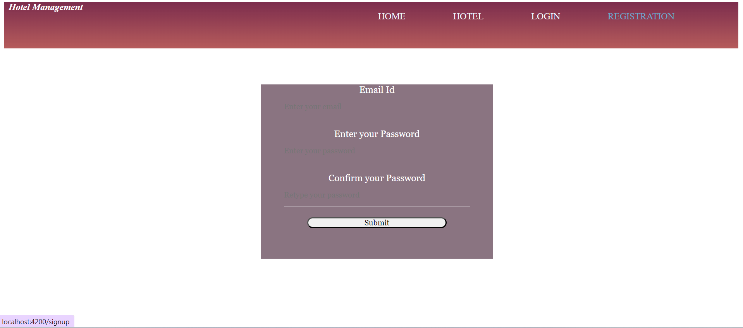
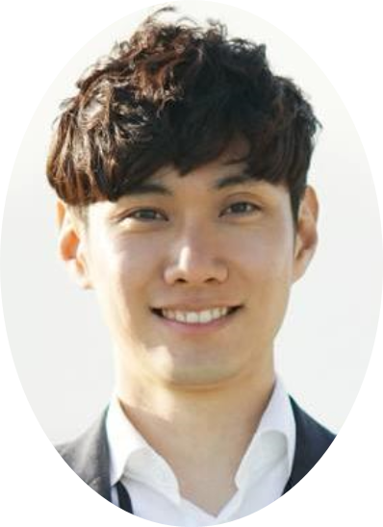


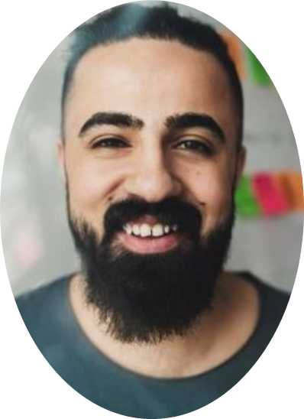
meet our team
TAKUMA HAYASHI
MIRJAM NILSSON​
FLORA BERGGREN​
RAJESH SANTOSHI
president
chief executive officer
chief operations officer
vp marketing

Slide 7
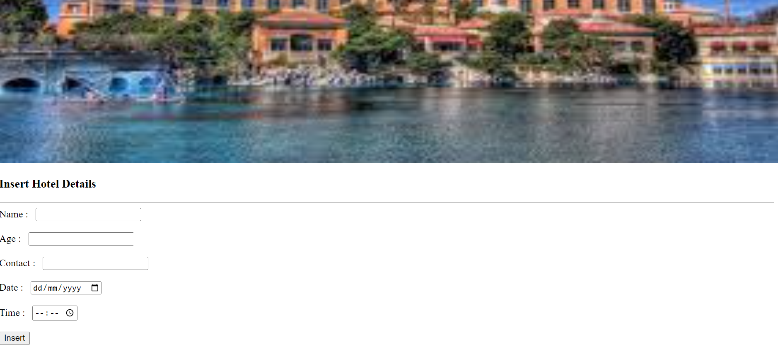




meet our extended team
TAKUMA HAYASHI
MIRJAM NILSSON​
FLORA BERGGREN​
RAJESH SANTOSHI
president
chief executive officer
chief operations officer
vp marketing
GRAHAM BARNES
ROWAN MURPHY
ELIZABETH MOORE
ROBINE KLINE
vp product
SEO strategist
product designer
content developer

Slide 8
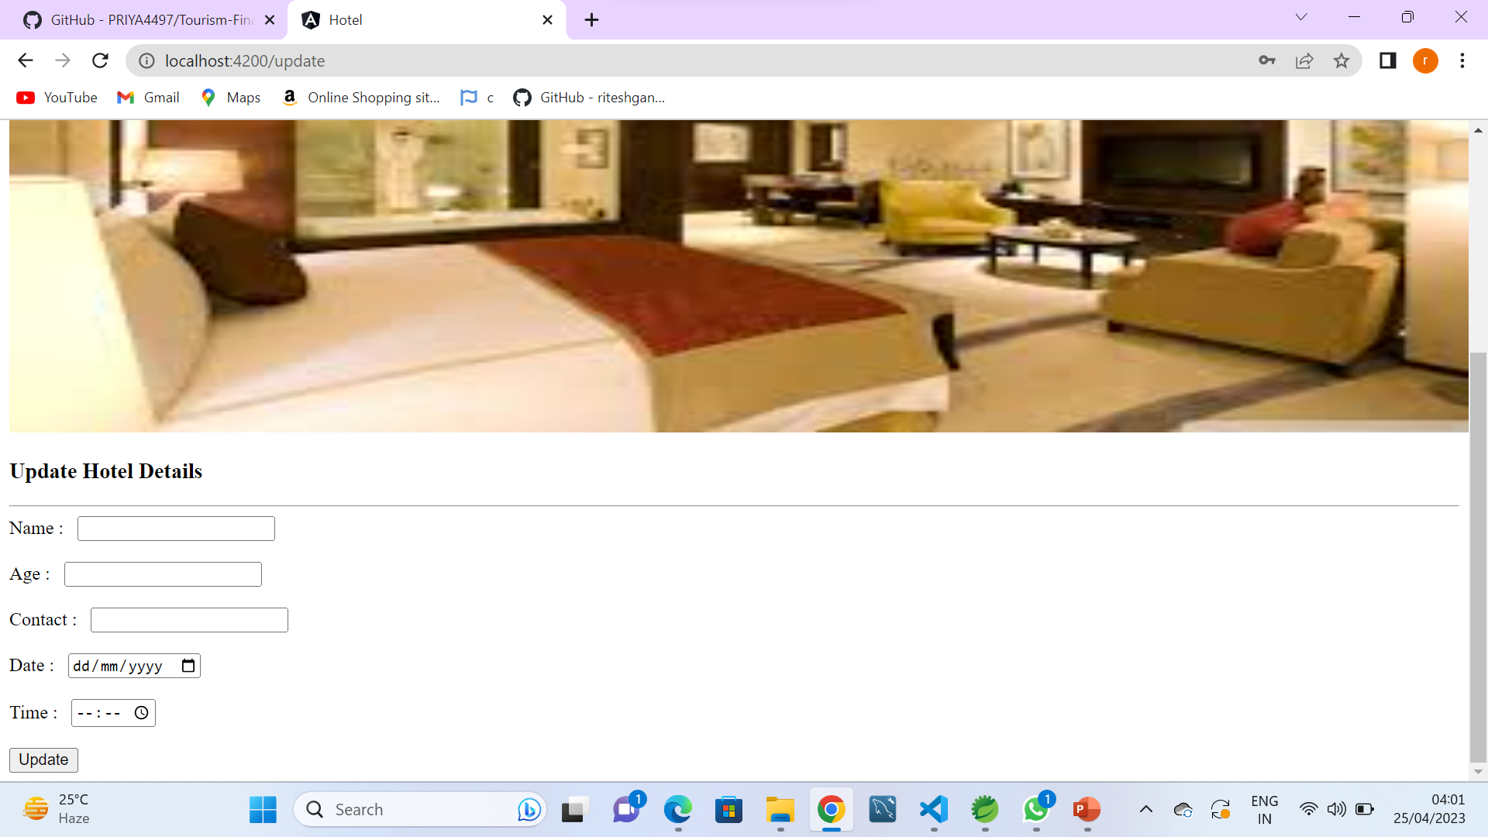
plan for product launch
deploy strategic networks with compelling e-business needs
PLANNING
synergise scalable e-commerce
MARKETING
disseminate standardised metrics
DESIGN
coordinate e-business applications
foster holistically superior methodologies
LAUNCH
STRATEGY

Slide 9
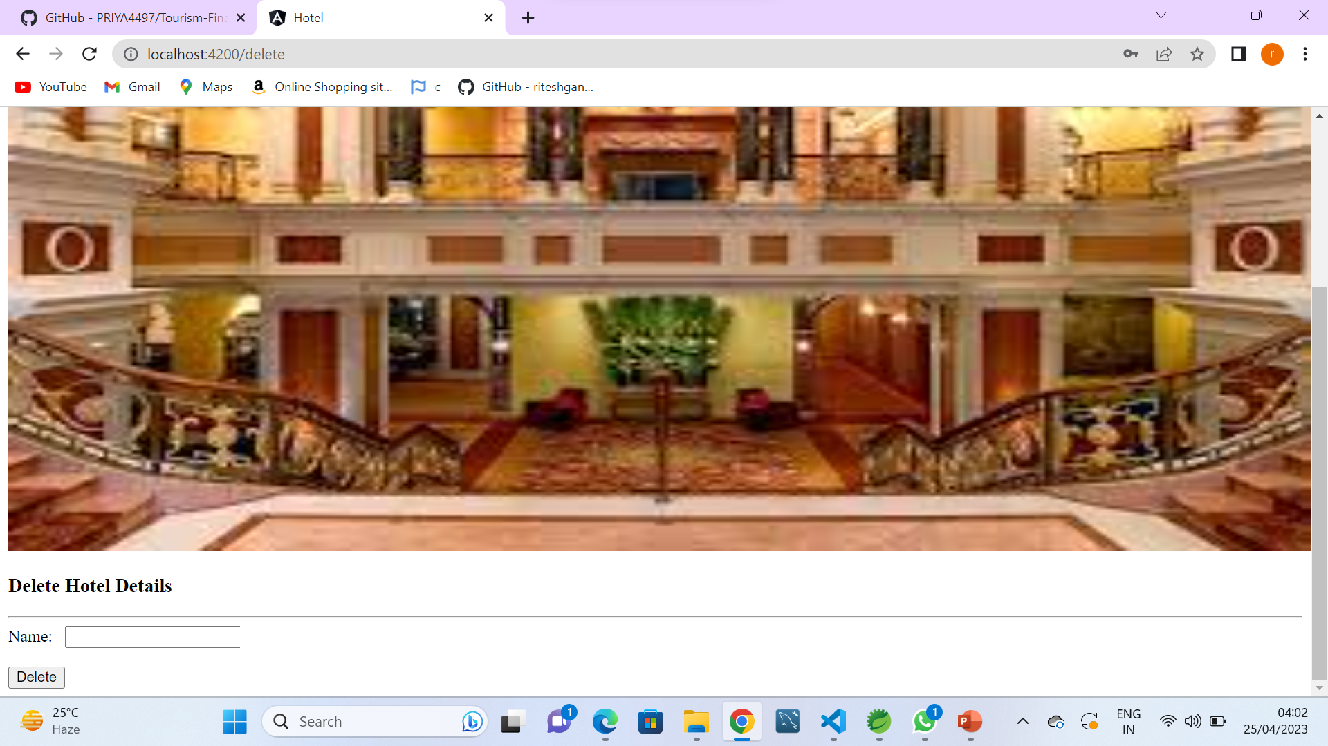
timeline
NOV 20XX
disseminate standardised metrics
SEP 20XX
synergise scalable e-commerce
JAN 20XX
coordinate e-business applications
MAR 20XX
foster holistically superior methodologies
MAY 20XX
deploy strategic networks with compelling e-business needs

Slide 10
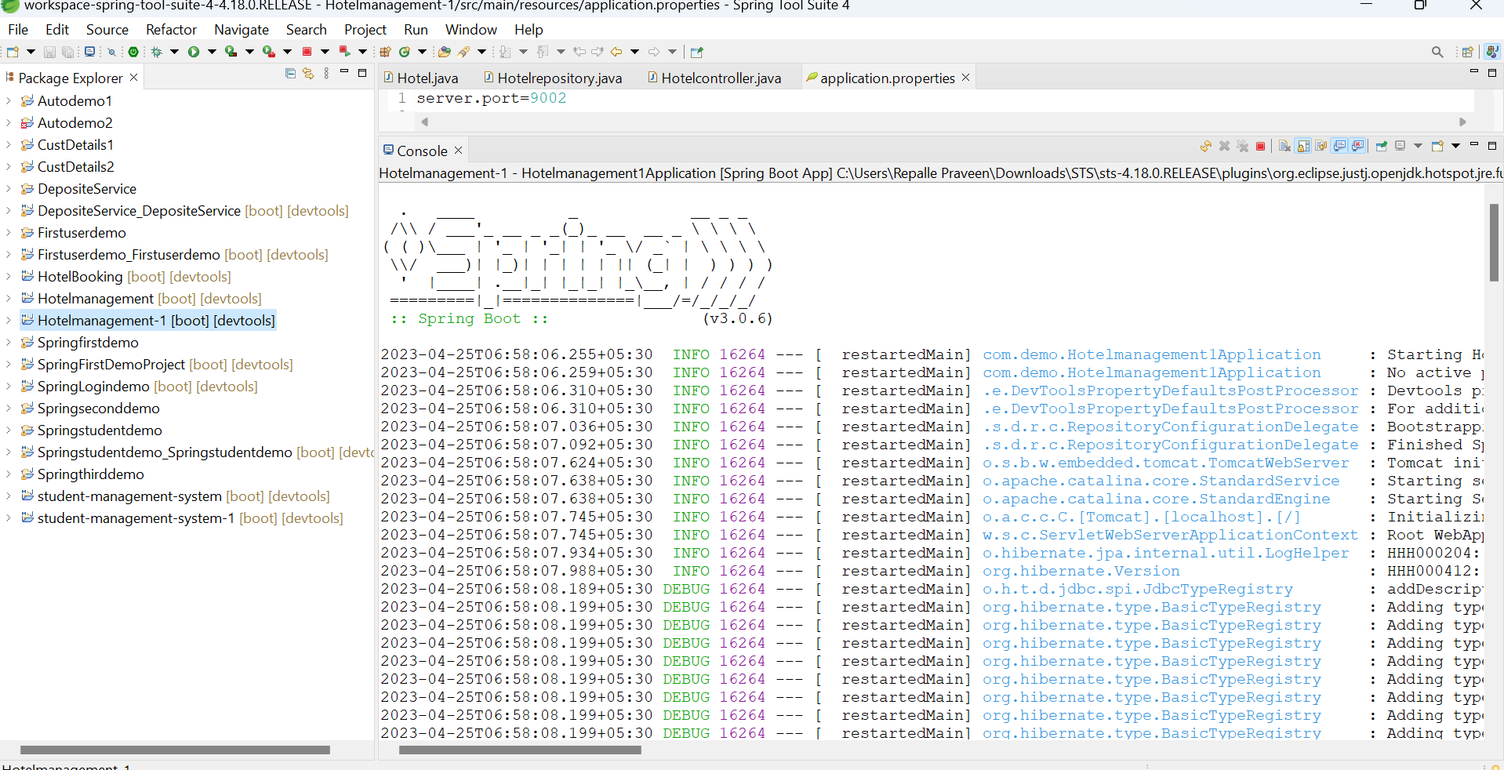
areas of focus
B2B MARKET SCENARIOS
Develop winning strategies to keep ahead of the competition
Capitalize on low-hanging fruit to identify a ballpark value
Visualise customer directed convergence​
CLOUD-BASED OPPORTUNITIES
Iterative approaches to corporate strategy
Establish a management framework from the inside

Slide 11
GIT HUB LINK

Slide 12

Future of the scope of the project
In the future of the project more services and
Friendly environment to satisfy the customer
Customer record insert update and delete operations more effectiveness creating

Slide 13
thank you
mirjam nilsson
mirjam@contoso.com
www.contoso.com

